Slide 1
Lostock Sustainable Energy Plant (SEP)
Local Liaison Committee
29th November 2018

Slide 2
AGENDA
Welcome & Introductions
Proposed Power Upgrade Application
Update on Site Works Since Last Meeting
Proposed Work Activities in Next 3 to 6 Months
Subsequent Project Works
Date of Next Meeting
AOB

Slide 3
Welcome & Lostock Site Rules
Welcome to the seventh Lostock SEP Local Liaison Committee
Office Rules
TATA representative will act as Guardian
No fire alarm test planned for today. If alarm sounds follow Guardian to muster point in staff car park at the rear of the building
Toilet facilities on this floor
Smoking Prohibited in the office.

Slide 4
Project Overview
Lostock Site History and Overview
Lostock Site commenced soda ash production in 1907; Brunner Mond (now TATA Chemicals Europe Ltd) acquired the site in 1904. Demolished and rebuilt new manufacturing plant.
Soda ash produced from brine (NaCl) and carbon dioxide (CO2)
Brine supplied from the Holford salt cavities operated by Inovyn
Carbon dioxide produced from the thermal decomposition of limestone with coke. Limestone railed in from Buxton
Ammonia is used as a catalyst (pH conditioner) to assist the chemical reaction
Soda Ash production is energy (heat) intensive. Steam required to drive the chemical reactions and dry the product.
The site operated its own coal fired power station (six boilers) up to the year 2000. Decommissioned when new gas fired CHP power plant started at Winnington

Slide 5
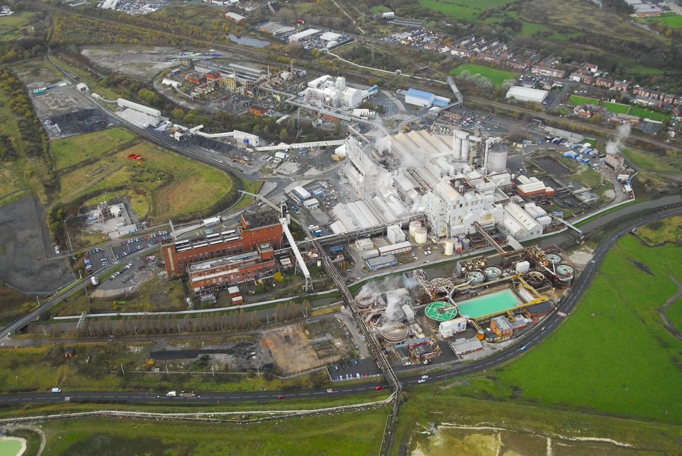
Lostock Site Aerial

Slide 6
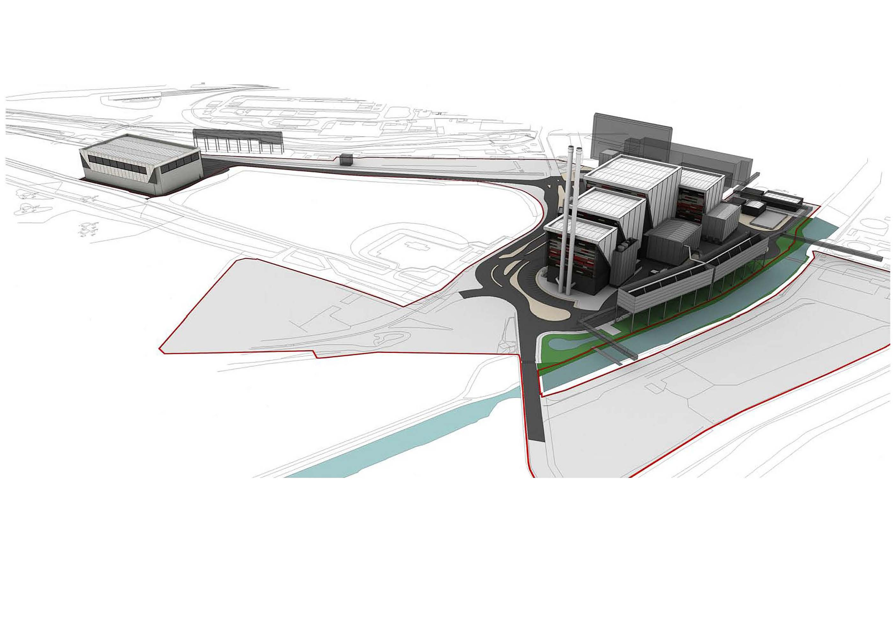
Lostock SEP: Project Overview

Slide 7
Lostock SEP Project
Power Upgrade Variation Application

Slide 8
Power Upgrade Variation Application
Background
As previously reported, technical studies conclude that the electrical power output the plant could deliver to the national grid could be increased.
Proposal developed for an electrical power increase of up to a further 30 MWe
This increase is delivered :
Without change in any of the parameters permitted under the existing consent granted by the Secretary of State on 2nd October 2012 for construction and operation of a EFW station generating up to 60 MWe
Enabled by efficiency improvements since consent was granted.
Special Local Liaison Committee meeting held on 15th March with Chris LeCointe, RPS, in attendance
Information leaflet and CD provided to allow local information sharing and opportunity to ask questions.

Slide 9
Power Upgrade Variation Application
Progress Update
A Variation Application was formally submitted to DBEIS seeking to vary the 2012 Consent to increase the power output of the Plant from the currently consented 60 MW to up to 90 MW.
DBEIS provided notice to TATA under Regulation 4(6) of the Variation Regulations that it considers the Variation Application to be suitable for publication.
TATA consequently published notice in accordance with Regulation 5(3) & (5) of the Variation Regulations on Thursday 2nd and 9th August 2018.
Application documents made available for inspection:
On SEP website: www.lostockpower.co.uk
At Northwich Library and at CWACC, Wyvern House, Winsford
Representations on the Variation Application were invited until 7th September 2018. Statutory consultation concluded on 4th October

Slide 10
Power Upgrade Variation Application
Progress Update (2)
Statutory Consultees included: Cheshire West and Chester Council and the Environment Agency
TATA has, via RPS responded to DBEIS on the points raised in the representations received.
The redacted representations and TATA’s response are now uploaded to the SEP website: lostockpower.co.uk .
DBEIS will consider the Variation Application and representations received and may consent to vary the 2012 Consent or may refuse to vary the consent.

Slide 11
Power Upgrade Variation Application
Progress Update (2)
Three main themes within the representations received for the variation application:
Fuel type
HGV Movements
Air Quality Impact
Fuel Type – Pre-treated waste and C&I was as dictated within Condition 31 and Condition 32.
HGV movements – as Condition 9 within the Planning Consent
BEIS assessed that the impact of the proposed variation and determined that no EIA was required as it was unlikely to have a significant impact.

Slide 12
Lostock SEP Project
Update on Site Works Since Last Meeting

Slide 13
Work Activities Since Last Meeting
Asbestos Removal
Specialist contractor working on site removing asbestos within the two main redundant power station buildings.
Expect to complete site works Quarter 1 of 2019.
Site Surveys
GPR survey of the entire site
Drain service CCTV survey
Bird netting of the power station buildings
Detailed Design of Enabling Work activities
Detailed design of the new water treatment plant and electrical sub-station being progressed. Aim to build and commission next year
Design specification for tie-ins. Aim to be completed in new year

Slide 14
Lostock SEP Project
Proposed Work Activities Over Next 3 to 6 Months

Slide 15
Work Activities in Next 3 to 6 Months
Installation of temporary workshops, amenities, offices and laboratory
Ground preparation for temporary facilities
Provision of required services
Demolish existing structures to make land areas available for the commencement of construction activities
Commence civil works for the new water purification plant and the new electrical sub-station
Complete identified tie-ins to allow water treatment plant to be commissioned
Commence demolition of sections of the redundant power station buildings
Submit planning applications for new Office block and workshops
Prepare areas for the construction of the new office block and workshops.
Environmental Permitting
Conclude with Environment Agency the TATA and LSEP permit boundaries

Slide 16
Lostock SEP Project
Subsequent Project Works

Slide 17
Lostock SEP: Subsequent Project Works
Efforts during early 2019 will largely focus on:
Commence demolition of the old coal fired power station buildings
Relocation of services to allow construction works to commence later in the year.

Slide 18
Lostock SEP: Date of Next Meeting
Proposed Dates for Future Meetings:
Thursday 28th February 2019
Thursday 23rd May 2019
Thursday 12th September 2019
Thursday 28th November 2019

Slide 19
Lostock SEP Project
AOB

