Slide 1
Lostock Sustainable Energy Plant (SEP)
Local Liaison Committee
24th May 2018

Slide 2
AGENDA
Welcome & Site Rules
Update on Site Works Since Last Meeting
Proposed Power Upgrade Application
Environmental Permitting
Proposed Work Activities in Next 3 to 6 Months
Subsequent Project Works
Date of Next Meeting
AOB

Slide 3
Welcome & Lostock Site Rules
Welcome to the fifth Lostock SEP Local Liaison Committee
Site Rules
Chemical Manufacturing Complex operating under strict Safety Rules and Procedures
TATA representative will act as Guardian
No fire alarm test planned for today. If alarm sounds follow Guardian to muster point outside gatehouse
Toilet facilities in office block next door
Smoking Prohibited on site.

Slide 4
Project Overview
Lostock Site History and Overview
Lostock Site commenced soda ash production in 1907; Brunner Mond (now TATA Chemicals Europe Ltd) acquired the site in 1904. Demolished and rebuilt new manufacturing plant.
Soda ash produced from brine (NaCl) and carbon dioxide (CO2)
Brine supplied from the Holford salt cavities operated by Inovyn
Carbon dioxide produced from the thermal decomposition of limestone with coke. Limestone railed in from Buxton
Ammonia is used as a catalyst (pH conditioner) to assist the chemical reaction
Soda Ash production is energy (heat) intensive. Steam required to drive the chemical reactions and dry the product.
The site operated its own coal fired power station (six boilers) up to the year 2000. Decommissioned when new gas fired CHP power plant started at Winnington

Slide 5
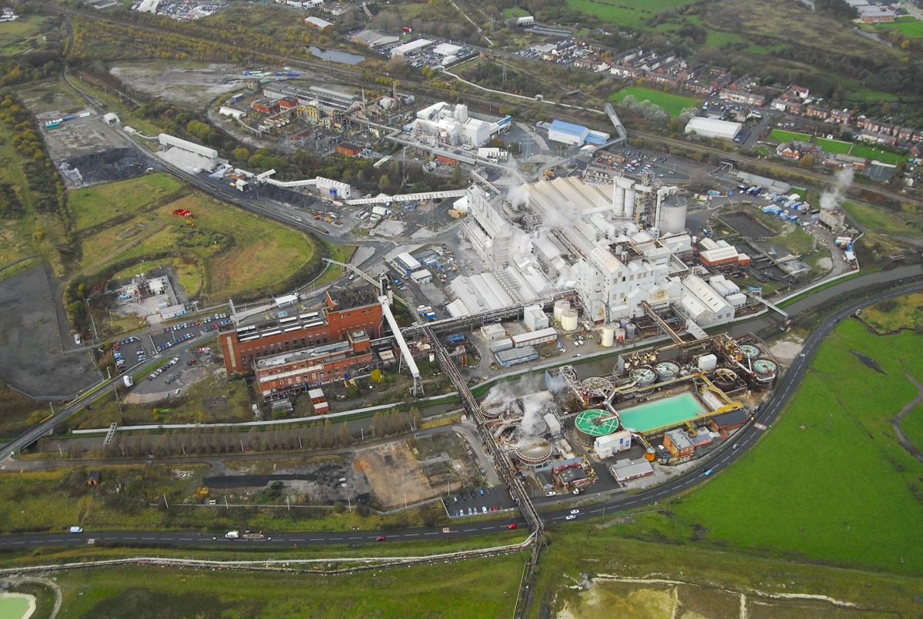
Lostock Site Aerial

Slide 6
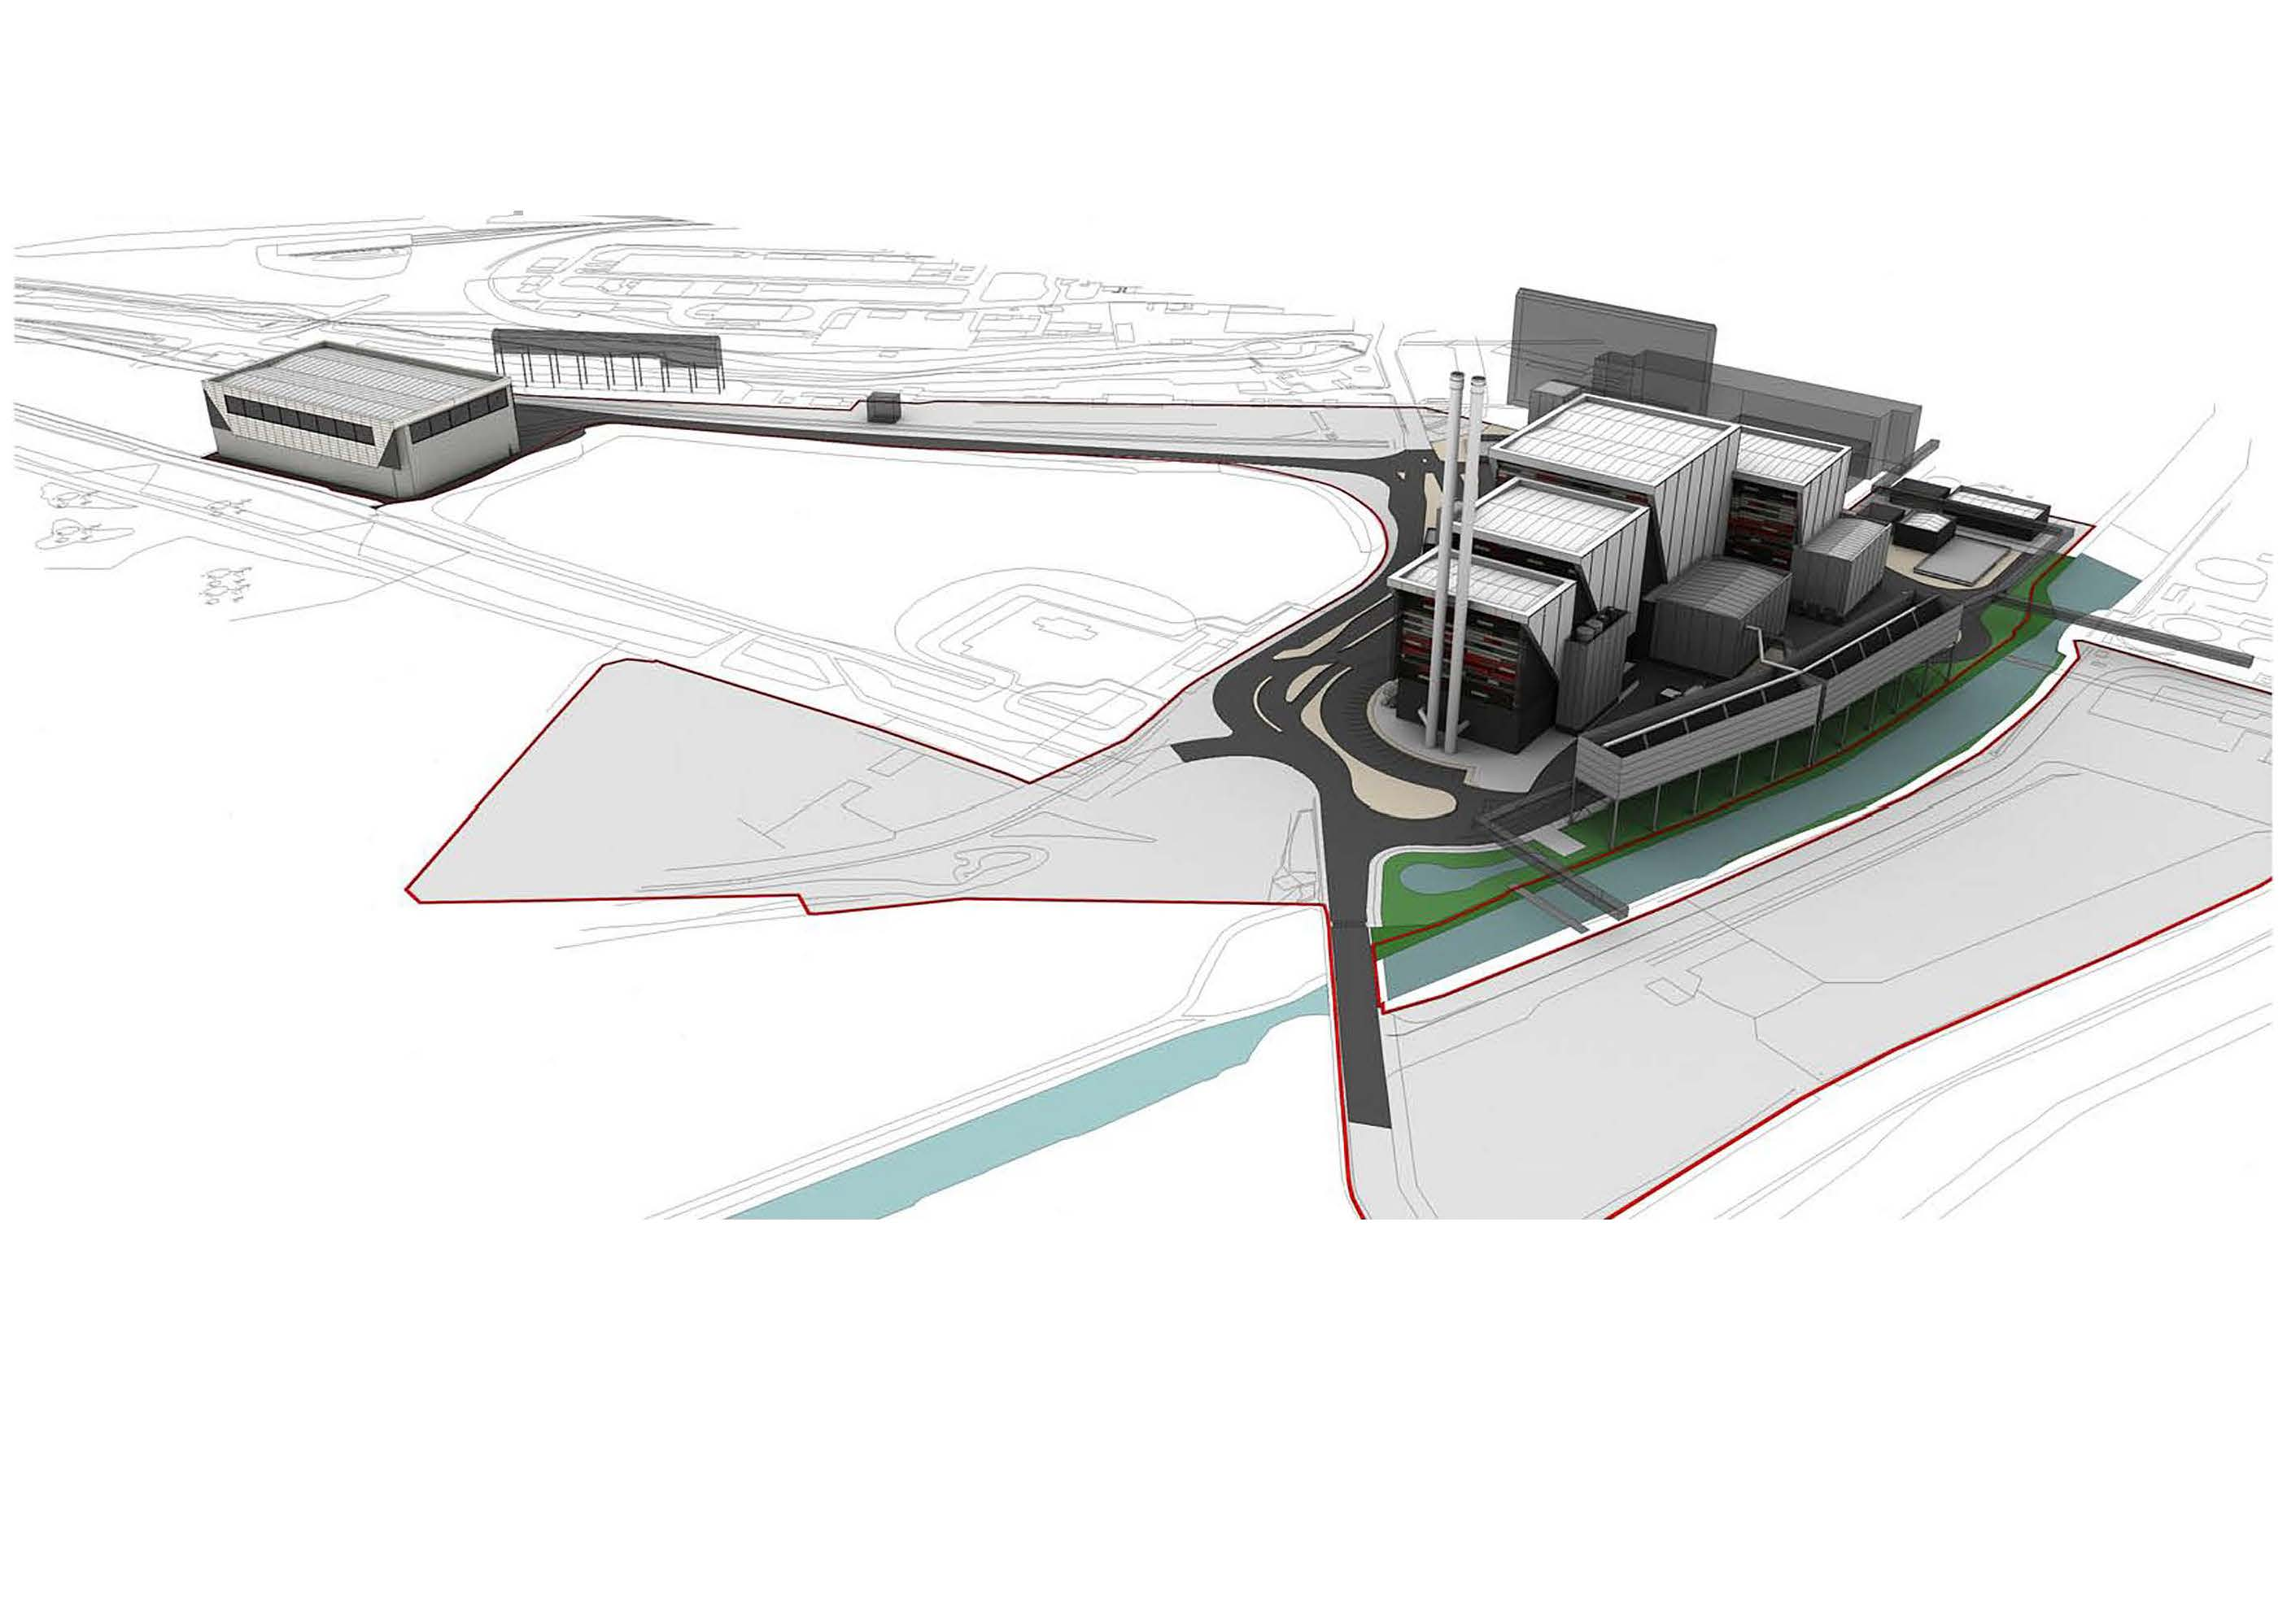
Lostock SEP: Project Overview

Slide 7
Lostock SEP Project
Update on Site Works Since Last Meeting

Slide 8
Work Activities Since Last Meeting
Collection of the necessary information and assessments to meet the requirements of planning condition 26 discharge approval (Prevention of Contamination of Land).
Site work commenced in January and completed in March. Scope of works included:
Concrete coring of all hard standing areas
Drilling 18 rotary / cable percussive boreholes to depths of 10m bgl and installation of monitoring standpipes within 9 boreholes
Drilling 22 window sample boreholes to depths of 4m bgl and installation of monitoring standpipes within 15 boreholes
Excavation of up to 44 trial pits to depths up to 4.5m bgl
Analysis of soil samples for chemical trace composition
In-situ vapour and ground gas monitoring
Geo-technical sampling and analysis for a range of tests
Sample collections continued into April
Analysis and reporting in progress

Slide 9
Work Activities Since Last Meeting
Enabling Work Packages– Developing Scopes
Stevie Mitchell appointed as TATA Site Integration Manager for Lostock SEP.
Civil, Mechanical and Electrical Contractors employed to assist with developing the scopes for the enabling work packages
Drone survey and topographical survey of the site.
First draft of the scope of enabling work packages now completed, approximately 15 discrete packages.
Complex activities due to interface with existing operating facilities
Live services (water, electricity, steam, chemicals, telecommunications, IT) running across the development land; both above and under ground need to be diverted.
Relocate water plant and electrical infrastructure
Relocate offices and workshop facilities
Now entering review and sign off stage

Slide 10
Work Activities Since Last Meeting
Development works to optimise the design and efficiency of the EfW plant.
As previously reported, technical studies conclude that the electrical power output the plant could deliver to the national grid could be increased.
Proposal being developed for an electrical power increase of up to a further 30 MWe
This increase is delivered :
Without change in any of the parameters permitted under the existing consent granted by the Secretary of State on 2nd October 2012 for construction and operation of a 600,000 tpa, EFW station generating up to 60 MWe
Enabled by efficiency improvements since consent was granted.
Special Local Liaison Committee meeting held on 15th March with Chris LeCointe, RPS, in attendance
Information leaflet and CD provided to allow local information sharing and opportunity to ask questions.

Slide 11
Work Activities Since Last Meeting
Development works to optimise the design and efficiency of the EfW plant.
Formal variation application would need to be submitted to the Department of Business, Energy and Industrial Strategy (DBEIS), formerly DECC.
Dialogue has been taking place with DBEIS to understand the requirements for the variation application
RPS submitted screening document to DBEIS for their review. Awaiting decision.
Currently producing the formal variation application. Date of submission yet to be confirmed
When application submitted then consultation with interested parties will commence
Pre-Commissioning Planning Condition Applications
Progress continues to discharge the remaining Pre-commissioning planning conditions
Condition 31 application submitted in April and discharged in May

Slide 12
Work Activities Since Last Meeting
Environmental Permit
Discussions continue with the Environment Agency.
Work on-going to agree TATA and LSEP permit boundaries and interface. Several options available for consideration
EA confirmed that the LSEP permit will come into operation following demolition of the redundant power station and/or when the construction of the foundations commences.

Slide 13
Lostock SEP Project
Proposed Work Activities Over Next 3 to 6 Months

Slide 14
Work Activities in Next 3 to 6 Months
Complete borehole sample and ground soil analysis
Analysis will be undertaken at third party laboratory
No further site work envisaged at this time
Pre-Commissioning Planning Condition Applications
Develop programme to submit applications
Primarily office based activities
Environmental Permitting
Conclude with Environment Agency the TATA and LSEP permit boundaries
Primarily office based activities
Complete sign off of Enabling Works scopes
Majority of work will be office based
Commence detailed design phase of enabling work packages
Design sign off for Water Treatment Plant and Electrical Sub-station

Slide 15
Lostock SEP Project
Subsequent Project Works

Slide 16
Lostock SEP: Subsequent Project Works
Efforts during the remainder of 2018 and early 2019 will largely focus on:
Asbestos removal and demolition of the old coal fired power station, which is likely to take place in 2019
Relocation of services to allow construction works to commence.

Slide 17
Lostock SEP: Date of Next Meeting
Date of Next Meeting:
To Be Agreed

Slide 18
Lostock SEP Project
AOB

