Slide 1

Lostock Sustainable Energy Plant (SEP)
Local Liaison Committee
1st March 2018

Slide 2
AGENDA
      Welcome & Site Rules
      Project Overview
      Update on Site Works Since Last Meeting
      Proposed Work Activities in Next 3 to 6 Months
      Subsequent Project Works
      Date of Next Meeting
      AOB

Slide 3
Welcome & Lostock Site Rules
  Welcome to the third Lostock SEP Local Liaison Committee
  Site Rules
    Chemical Manufacturing Complex operating under strict Safety Rules and Procedures
    TATA representative will act as Guardian
    No fire alarm test planned for today. If alarm sounds follow Guardian to muster point outside gatehouse
    Toilet facilities in office block next door
    Smoking Prohibited on site.

Slide 4
Project Overview
Lostock Site History and Overview
  Lostock Site commenced soda ash production in 1907; Brunner Mond (now TATA Chemicals Europe Ltd) acquired the site in 1904. Demolished and rebuilt new manufacturing plant.
  Soda ash produced from brine (NaCl) and carbon dioxide (CO2)
    Brine supplied from the Holford salt cavities operated by Inovyn
    Carbon dioxide produced from the thermal decomposition of limestone with coke. Limestone railed in from Buxton
    Ammonia is used as a catalyst (pH conditioner) to assist the chemical reaction
  Soda Ash production is energy (heat) intensive. Steam required to drive the chemical reactions and dry the product.
  The site operated its own coal fired power station (six boilers) up to the year 2000. Decommissioned when new gas fired CHP power plant started at Winnington

Slide 5
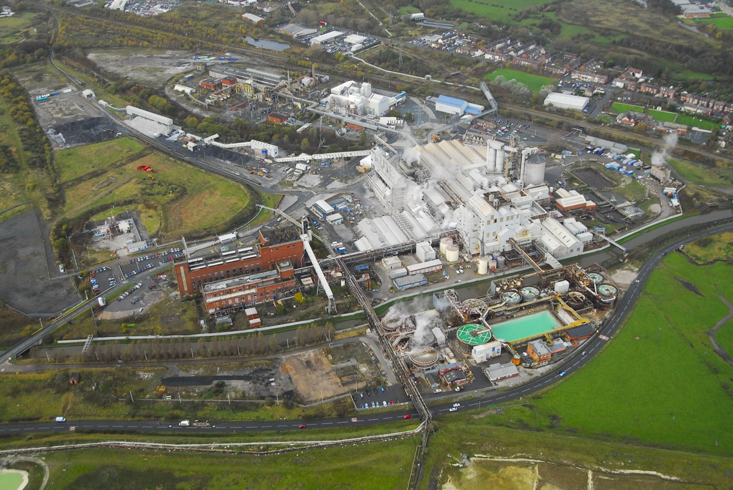
Lostock Site Aerial

Slide 6
Lostock SEP: Project Overview
Project initiated in 2009 as a joint venture between TATA and E.on Energy from Waste (EEW).
Planning application submitted to the Department of Energy and Climate Change (under Section 36 Electricity Act 1989) in February 2010. Planning consent awarded in October 2012 for a 60 MW generating station.
Sustainable Energy Plant would produce approx. 50 MWe of electricity exported to the National Grid. TATA would take steam for its chemical manufacturing process
The plant will take approximately 600,000 tonnes per year of refuse derived fuel (RDF)
The new power plant will be constructed on the site of the redundant coal fired power station
Construction of new power plant will take in the region of 3 years following enabling works, preparation and demolition, (see next slide)

Slide 7
Lostock SEP: Project Overview
Prior to construction an extensive demolition and enabling phase of works needs to be completed including:
    Asbestos removal
    Replacement and relocation of key electrical and water treatment facilities
    Replacement and relocation of offices, workshops, storage facilities
    Demolition of redundant coal fired power station

Slide 8
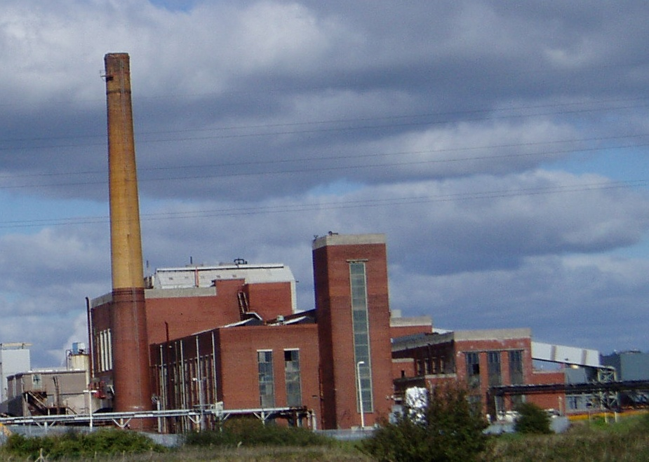
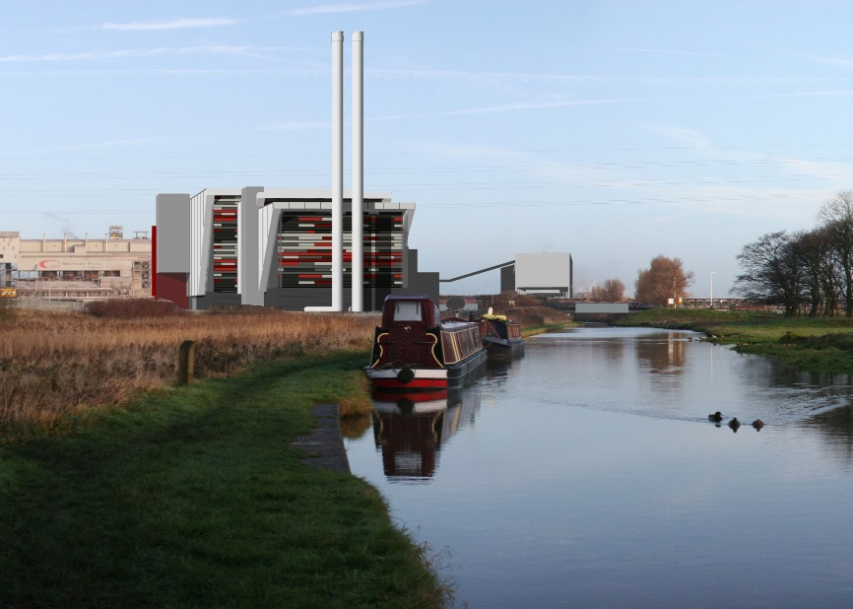
Lostock Sustainable Energy Plant SEP - Overview

Slide 9
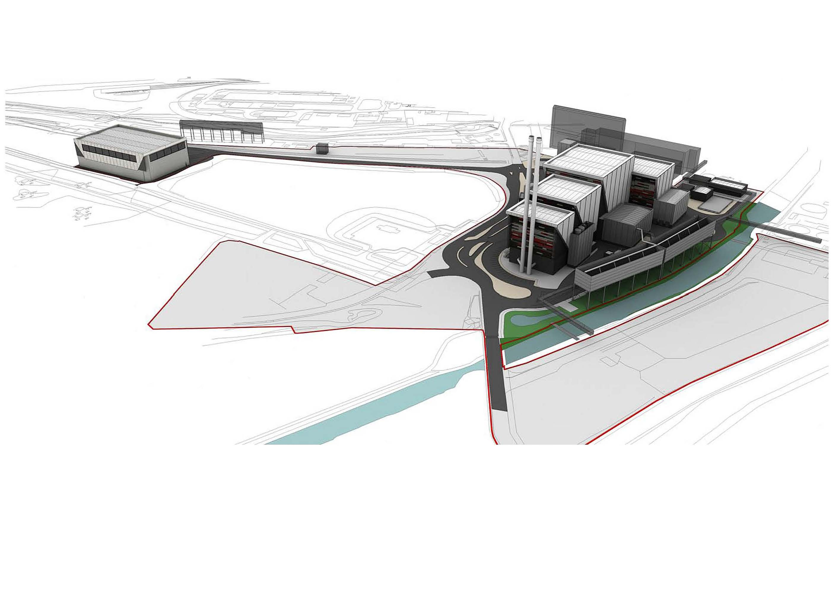
Lostock SEP: Project Overview

Slide 10
Lostock SEP Project
  Update on Site Works Since Last Meeting

Slide 11
Work Activities Since Last Meeting
Collection of the necessary information and assessments to meet the requirements of planning condition 26 discharge approval (Prevention of Contamination of Land).
Site work commenced in January and due to complete by mid- March. Scope of works included:
    Concrete coring of all hard standing areas
    Drilling 18 rotary / cable percussive boreholes to depths of 10m bgl and installation of monitoring standpipes within 9 boreholes
    Drilling 22 window sample boreholes to depths of 4m bgl and installation of monitoring standpipes within 15 boreholes
    Excavation of up to 44 trial pits to depths up to 4.5m bgl
    Analysis of soil samples for chemical trace composition
    In-situ vapour and ground gas monitoring
    Geo-technical sampling and analysis for a range of tests

Slide 12
Lostock SEP Project

Slide 13
Work Activities Since Last Meeting
Enabling Work Packages– Developing Scopes
  Stevie Mitchell appointed as TATA Site Integration Manager for Lostock SEP. Stevie is responsible for leading and delivering the site enabling activities on TATA’s behalf
  Civil, Mechanical and Electrical Contractors now employed to assist with developing the scopes for the enabling work packages
  Scoping of the enabling work packages, approximately 15 discrete packages has commenced.
    Complex activities due to interface with existing operating facilities
    Live services (water, electricity, steam, chemicals, telecommunications, IT) running across the development land; both above and under ground need to be diverted.
    Relocate water plant and electrical infrastructure
    Relocate offices and workshop facilities

Slide 14
Work Activities Since Last Meeting
Development works to optimise the design and efficiency of the EfW plant.
Technical studies conclude that the electrical power output the plant could deliver to the national grid could be increased.
Proposal being developed for an electrical power increase of up to a further 30 MWe
  This increase is delivered :
    Without change in any of the parameters permitted under the existing consent granted by the Secretary of State on 2nd October 2012 for construction and operation of a 600,000 tpa, EFW station generating up to 60 MWe
    Enabled by efficiency improvements since consent was granted.
Process going forward
  Discussion with the Local Liaison Committee
  Formal variation application to Department of Business, Energy and Industrial Strategy (DBEIS), formerly DECC.
  Consultation with interested parties

Slide 15
Lostock SEP Project
Proposed Work Activities Over Next 3 to 6 Months

Slide 16
Work Activities in Next 3 to 6 Months
Complete Borehole sampling and ground soil analysis
  Minimal site activity associated with collecting samples
  Analysis will be undertaken at third party laboratory
Pre-Commissioning Planning Condition Applications
  Develop programme to submit applications
Environmental Permitting
  Working with Environment Agency to agree TATA and LSEP permit boundaries
  Primarily office based activities
Complete Enabling Works Scoping
  Majority of work will be office based
  Some site design activity to confirm measurements and locations
Design sign off for Water Treatment Plant and Electrical Sub-station

Slide 17
Lostock SEP Project
Subsequent Project Works

Slide 18
Lostock SEP: Subsequent Project Works
Efforts during the remainder of 2018 will largely focus on:
  Detailed design of the enabling work packages
  Subsequent demolition of the old coal fired power station, which is likely to take place in 2019

Slide 19
Lostock SEP: Date of Next Meeting
  Date of Next Meeting:
  Thursday 24th May 2018 at 2PM Lostock Site

Slide 20
Lostock SEP Project
AOB
Date of special Local Liaison Committee meeting: Mid March potentially

