Slide 1
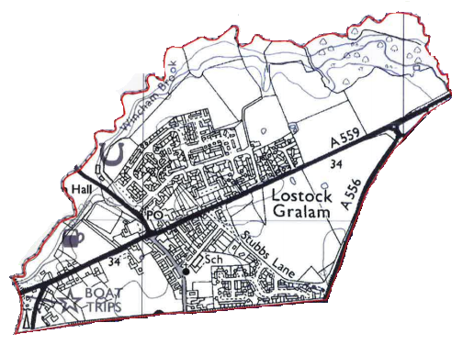
Welcome to the Parish of Lostock Gralam
Extraordinary Lostock Gralam Parish Council Meeting with the Rt. Honourable Esther McVey
Tuesday 3rd April 2018

Slide 2
Agenda
Introduction
Purpose of the Extraordinary Meeting
Key Lostock Gralam Issues
HS2
Lostock Works
Lack of Facilities & Services
Speeding on Manchester Road
Summary
AOB

Slide 3
Introduction
Lostock Gralam is a relatively small parish with a tax base of 745.
The Parish is surrounded by some big businesses;
INEOS Holford Brinefieds – Produces brine which is an essential building block for the production of plastics, water treatment chemicals and food grade salt . 2.5 million tonnes of salt are extracted on an annual basis using a controlled solution mining technique.
Storengy Stublach Site – is the biggest salt cavern storage facility in the UK. Natural gas is stored over 500 metres below the surface in salt caverns. The 450 million cubic metres of gas stored at Stublach is enough to supply 270,000 homes with gas for cooking and heating for 12 months.
Renescience –Orsted at Lostock Works – ground breaking biotechnology that converts household waste into energy. Can generate 5MW of clean energy, enough to power 9,500 UK homes. Treats up to 120,000 tons of waste per year from 110,000 UK homes.
Lostock Sustainable Energy Plant (TATA) at Lostock Works - energy from waste generating station of up to 90MWe (current planning up to 60MWe) from 600,000 tons of waste per year.

Slide 4
Purpose of the Meeting
The Lostock Gralam Parish Councillors are passionate about the place they live and want to improve and enrich the lives of Lostock Gralam residents.
Lostock Gralam has some big businesses but it also has some big issues to.
The residents above all want to be heard and to not be the dumping ground for everything that nobody else wants.
We hope to paint a bigger picture through the remainder of this presentation.

Slide 5
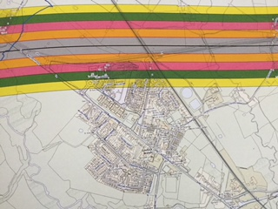
HS2 and its impact on Lostock Gralam
presented by
Councillor Tim Smith

Slide 6
HS2
Lostock Gralam will be decimated by HS2 & be one of the most affected villages on the line!
Potential for 80 foot high embankments.
Massive viaduct spanning Lostock and surrounding countryside.
Passing right next to numerous residential homes, a hotel and a new care home.
At the HS2 Implementation Advisory Group, I had to ask them to add impact and mitigation to the TOR !
The route is unsafe and ill thought through
The engineers have accepted this is one of the most challenging parts of the whole route.
HS2 route selection missed 20+ giant gas storage facilities, 170+ brine wells, 2 ethylene cavities, and a dense network of high pressure brine, air and gas pipelines.
The new route is squeezed between, and over these !

Slide 7
HS2 continued
The construction will have to start up to 10 years before a train is seen
Rerouting of A556 will be a nightmare.
Large elevated viaduct construction will cause chaos to the area.
Lostock & Northwich will be grid locked for a decade, (without the other projects, we will come on to).
The business case is deeply flawed
The Commons Treasury select committee says so
many benefits are intangible, and built on optimistic regeneration and indirect economic growth assumptions
The assumption that you can’t work on a train, is mind blowing !
The project appears troubled, unconnected and will deliver technology that will be outdated on implementation
We would prefer the money spent on upgrading the northern lines, the NHS or even potholes !

Slide 8
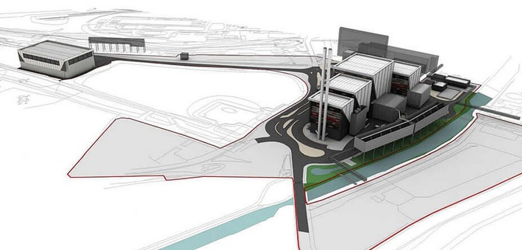
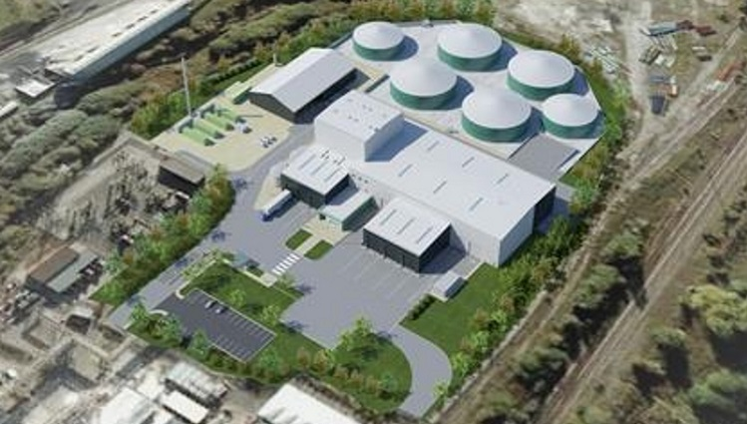
Lostock Works and its impact on Lostock Gralam
presented by
Councillor Tim Hodges
TATA Chemicals
Orsted -Renescience

Slide 9
Lostock Works
Waste recycling in the Lostock Gralam Area
Tata Sustainable Energy Plant (or known as the incinerator) Lostock Works, Griffiths Rd, Lostock Gralam.
It was estimated that it will take 5 years from Nov 2017 to build the new power station which will produce 50 Mw from waste pellets.
Stack will be 90 metres high.600, 000 tonnes of pellets per year to be supplied involving 240 lorry movements per day.
Work done to date has involved clearing vegetation and odd buildings around site. Demolition of the old power station is to be done over the next 18 months.
It is important to get the road improvements completed on Griffiths Rd.

Slide 10
Lostock Works continued
Waste recycling in the Lostock Gralam Area
Orsted formerly Dong Energy, Lostock Works, Griffiths Rd, Lostock Gralam.
Renescience is a technology that promises to turn 95% of household waste into electricity – this is a very green project that is the first in the UK and uses enzymes to break materials down and produce the gas to drive the turbines.
They expect to generate 5 MW of power per annum- enough to provide for 9500 homes following treatment of 120,000 tonnes of waste from 110,000 homes.
However green, there is still the question of vehicle movements which when in full production will be 20 per hour.

Slide 11
Lostock Works continued
Organic Waste Management Ltd, Lostock Works, Griffiths Rd, Lostock Gralam.
An inadequate level of consultation and notification of the application to Lostock Gralam PC.( Turns out we were the only Parish Council not notified and that this planning application was originally received in 2008 and approved in 2011.)
We are very concerned at the polluting impact on the area which includes schools, residential housing as well as commercial premises.
A planning application to raise the stack height initially from 20 to 33 metres was made when changing the process from a bio-reactor and separator, to that of a moving grate incinerator and then there was a further application to raise
the stack from 33 to 52 metres (which was subsequently withdrawn on 13 February 2018 due to local opposition).
A significant change and we feel that when a further planning application is received for the higher stack then a revised planning application for the whole plant, with appropriate levels of consultation with surrounding parishes be carried out because many local people will be effected.
The Council seems to also be ignoring the impact of road traffic movements and their effect on air quality. There needs to be renewed emphasis on the impact of emissions from HGVs on the health of citizens

Slide 12
Lostock Works Summary
What action do we want from our local MP the Rt. Honourable Esther McVey?
There is enough polluting activity on the Lostock site both existing and planned and any further development should be for cleaner low carbon technologies.
We would ask for your support for an air monitoring station to be located at the site and at key locations on Manchester Rd and Griffiths Rd .Checks would then be made on emissions from both waste treatment and heavy vehicles enabling corrective action to be taken before damage to health occurs.

Slide 13
Lack of Facilities & Services
Presented
by
Councillor Vince Yarwood

Slide 14
Lack of Facilities & Services
Lostock Gralam has seen many new build properties over recent years but doesn't have the facilities to accommodate the increasing number of residents.
No available land to expand the Primary School.
No available land to provide allotments.
No doctors surgery in Lostock Gralam.
Improvements to the bus and rail transport links needed to support the local community & the Cheshire Business Park.
Reduced PCSO cover from April 2018 due to changes in funding. The Parish will share one PCSO with the Shakerley Ward.

Slide 15
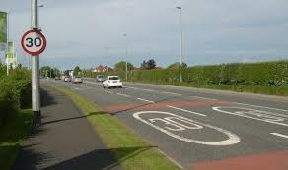
Speeding on Manchester Road and its impact on Lostock Gralam
by
Councillor Pete Kelly

Slide 16
Speeding on Manchester Road
I became a Parish Councillor after a child was killed on Manchester Road several years ago, and have been frustrated by the red tape of CWAC Highways.
I have proven that Manchester Road is dangerous.
Many people have lost their lives on this road over time and there have been many serious recorded accidents.
I have attended many meeting with CWAC Highway Officers about speeding problems on this road that is unnecessarily putting lives at risk.
One Officer from Highways summed up at one meeting with an unbelievable statement that has stuck in my mind;
“There has to be three deaths in one year inside one mile distance of the other two before Highways will look into the safety measures on this road”
The same Officer under pressure about 10 years ago moved the 30mph signs half way between the Business Park traffic lights to the gyratory but refused to move them closer because motorists needed time to adjust from 60mph of the A556 onto 30mph of the A559 Manchester Road.
Thankfully he no longer works for CWAC Highways!

Slide 17
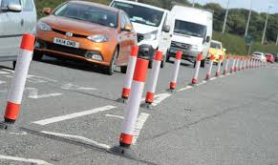
Speeding on Manchester Road continued
Since the New Year, there have been four serious accidents, thankfully nobody was badly injured, but the cars were at best badly damaged, if not wrote off.
One pedestrian had a very near miss, when a car lost control and mounted the pavement.
It has been eight years since that poor little girl lost her life on Manchester Road and all CWAC Highways have done is install two interactive signs which the Parish Council paid for. Installed cones that drop when hit by a car or lorry then pop up when the vehicle has gone past. All 28 cones were badly damaged so they had to be removed.
They too were paid for by the Parish Council.
All CWAC Highways have done is replace two old 30 mph signs and agreed with the developer of the Cheshire Business Park to put a controlled crossing in place which hardly anybody uses due to its poor location, which the Parish Council have pointed out many times.

Slide 18
Manchester Road Speeding continued
Around two years ago under pressure CWAC Highways installed a 360 degree radar machine that sat on a lamp post, it was there for a week. The Machine can record every motor going past from a push bike to a lorry, both ways at the same time, we are still awaiting the results!
Some Parish Councillors like me have been trained to use a SID Machine and speed guns. CWAC Highways promised to give the Parish Council the data collected on a floppy disc, this information has never been received because it was so damming.
When we first used the machines 6/7 years ago they recorded over 2000 vehicles in a 24 hour period to be speeding over 40 mph. The results were so damming that CWAC Highways said the machines were faulty.
Under pressure CWAC Highways offered the machines back but only as an educational tool, and no data would be used. The Parish Council refused.
We as a Parish Council would like average speed cameras installed on this road, because we feel it would make a huge difference to slow vehicles down.
Highways and the Police shift responsibility to each other and are caught up in endless red tape which is preventing any progress.

Slide 19
Speeding on Manchester Road Summary
I am asking you, our MP, can you fight with the Parish Council to resolve important issues before someone else is killed or badly injured?
What we would like you to help us with;
Push CWAC Highways to move the 30mph signs to the gyratory.
Push to have average speed cameras installed from the gyratory along the A559 Manchester Road.
Push to have a zebra crossing where is matters leading to the Community Centre and School.
Install cameras which record red light jumpers.
I am more than happy to have a meeting with you and CWAC Highways to move forward.

Slide 20
Summary
Lostock Gralam is a small parish with some large challenges ahead.
There is the potential for a ‘perfect storm’ due to the timing and enormity of the infrastructure projects that could blight and grid lock our Parish for years to come.
The Lostock Gralam Parish Council wish to gain your help and support throughout your term in office, whilst we battle to improve and protect the lives of those who live in our Parish.

Slide 21
We look forward to an improving picture with your help

