Slide 1
Lostock Sustainable Energy Plant (SEP)
Local Liaison Committee
28th February 2019

Slide 2
AGENDA
Welcome & Introductions
Proposed Power Upgrade Application
Update on Site Works Since Last Meeting
Proposed Work Activities in Next 3 to 6 Months
Subsequent Project Works
Date of Next Meeting
AOB

Slide 3
Welcome & Lostock Site Rules
Welcome to the Eighth Lostock SEP Local Liaison Committee
New member to the Committee: Steve James representing the local community
Office Rules
TATA representative will act as Guardian
No fire alarm test planned for today. If alarm sounds follow Guardian to muster point in staff car park at the rear of the building

Slide 4
Project Overview
Lostock Site History and Overview
Lostock Site commenced soda ash production in 1907; Brunner Mond (now TATA Chemicals Europe Ltd) acquired the site in 1904. Demolished and rebuilt new manufacturing plant.
Soda ash produced from brine (NaCl) and carbon dioxide (CO2)
Brine supplied from the Holford salt cavities operated by Inovyn
Carbon dioxide produced from the thermal decomposition of limestone with coke. Limestone railed in from Buxton
Ammonia is used as a catalyst (pH conditioner) to assist the chemical reaction
Soda Ash production is energy (heat) intensive. Steam required to drive the chemical reactions and dry the product.
The site operated its own coal fired power station (six boilers) up to the year 2000. Decommissioned when new gas fired CHP power plant started at Winnington

Slide 5
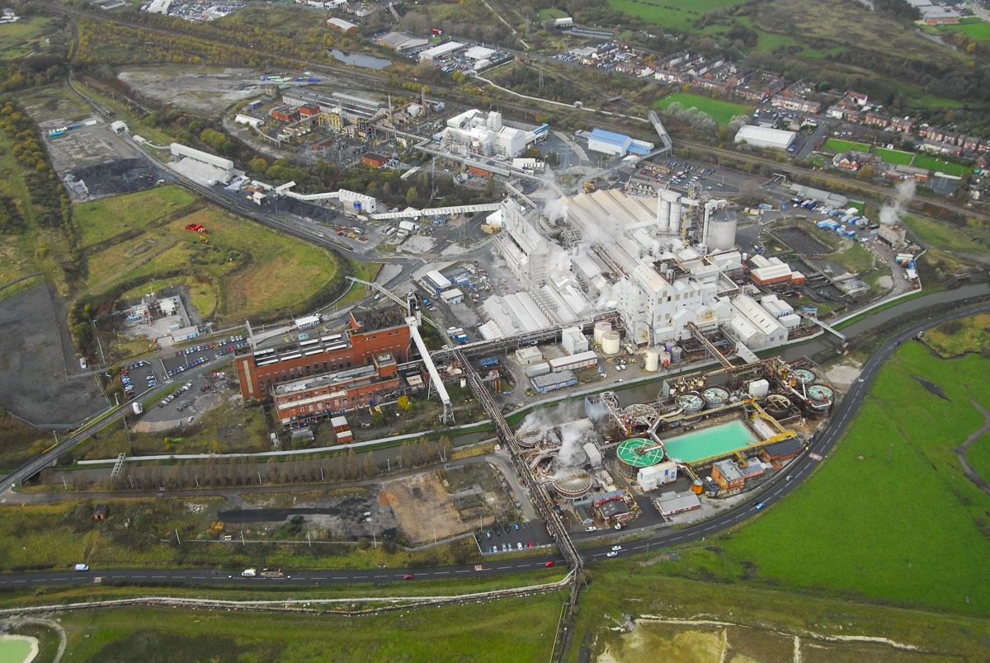
Lostock Site Aerial

Slide 6
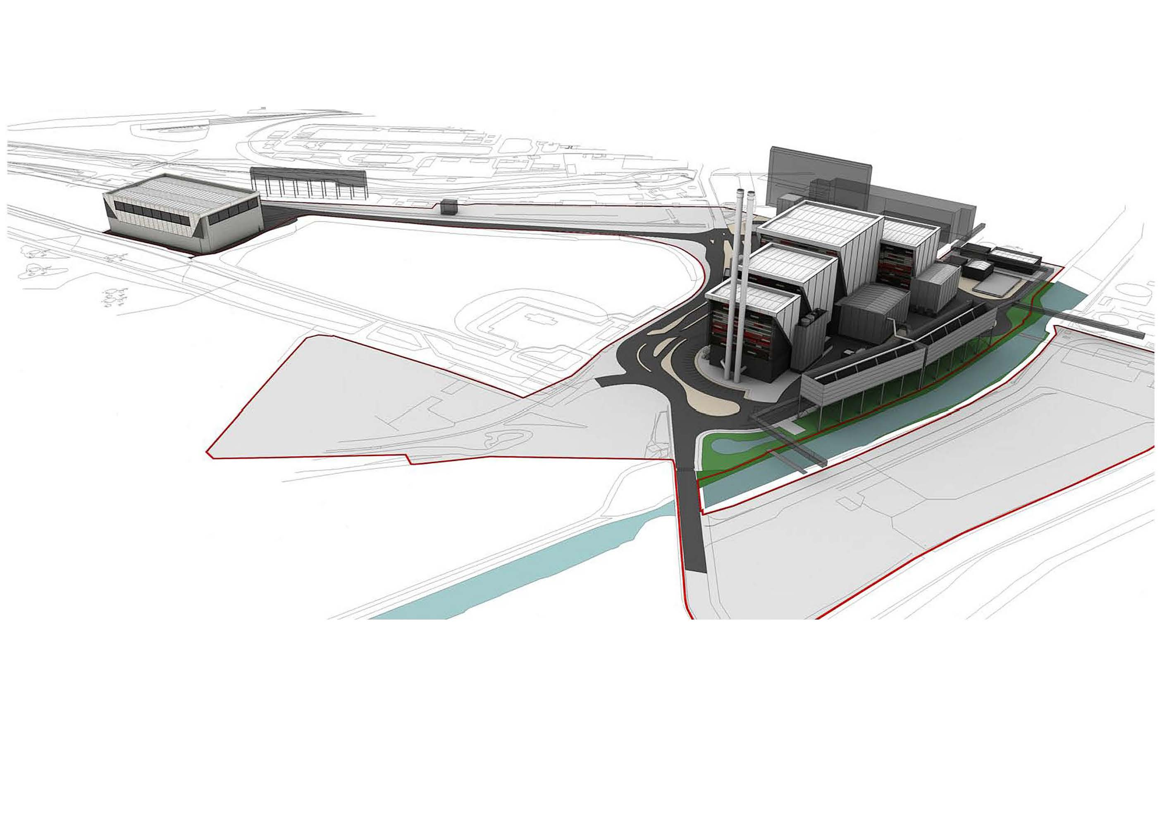
Lostock SEP: Project Overview

Slide 7
Lostock SEP Project
Power Upgrade Variation Application

Slide 8
Power Upgrade Variation Application
Background
As previously reported, technical studies conclude that the electrical power output the plant could deliver to the national grid could be increased.
Proposal developed for an electrical power increase of up to a further 30 MWe
This increase is delivered :
Without change in any of the parameters permitted under the existing consent granted by the Secretary of State on 2nd October 2012 for construction and operation of a EFW station generating up to 60 MWe
Enabled by efficiency improvements since consent was granted.
A Variation Application was formally submitted to DBEIS seeking to vary the 2012 Consent to increase the power output of the Plant from the currently consented 60 MW to up to 90 MW.
Representations on the Variation Application were invited until 7th September 2018. Statutory consultation concluded on 4th October

Slide 9
Power Upgrade Variation Application
Progress Update (2)
Statutory Consultees included: Cheshire West and Chester Council and the Environment Agency
TATA has, via RPS responded to DBEIS on the points raised in the representations received.
The redacted representations and TATA’s response are now uploaded to the SEP website: lostockpower.co.uk .
DBEIS will consider the Variation Application and representations received and may consent to vary the 2012 Consent or may refuse to vary the consent.

Slide 10
Lostock SEP Project
Update on Site Works Since Last Meeting

Slide 11
Work Activities Since Last Meeting
Asbestos Removal
Specialist contractor working on site removing asbestos within the two main redundant power station buildings: Boiler House and Turbine Hall.
Expect to complete site works during the first half of 2019.
New Office and Workshop Facilities
Planning applications submitted
Detailed Design of Enabling Work activities
Detailed design of the new water treatment plant and electrical sub-station being progressing well. Safety studies commenced. On track to build and commission this year

Slide 12
Work Activities Since Last Meeting
Service Diversions
A number of existing services need to be diverted as part of the site enabling works. Several of these require the production facility to be shutdown.
Planning to complete these in May 2019
This requires significant effort to design and complete detailed planning to undertake the works within a short time period
On completion this will allow the next phase of implementing works to clear an area of site to install the new water treatment plant and electrical sub-station. This is necessary to allow the power station buildings to be demolished.

Slide 13
Work Activities Since Last Meeting
Legal Agreements and Contracts
Significant resource and effort has been expended on drafting and reaching agreement on the legal and contractual elements of the project.
The complexity of the project; building and integrating a new power plant into the Lostock manufacturing complex cannot be underestimated and has taken time
Close to finalising all these elements.

Slide 14
Lostock SEP Project
Proposed Work Activities Over Next 3 to 6 Months

Slide 15
Work Activities in Next 3 to 6 Months
Complete asbestos removal within the two power station buildings
Complete asbestos removal on external services
Installation of temporary workshops, amenities, offices and laboratory
Ground preparation for temporary facilities
Provision of required services
Demolish existing structures to make land areas available for the commencement of construction activities
Commence civil works for the new water purification plant and the new electrical sub-station
Commence demolition of sections of the redundant power station buildings
Prepare areas for the construction of the new office block and workshops.
Environmental Permitting
Conclude with Environment Agency the TATA and LSEP permit boundaries

Slide 16
Lostock SEP Project
Subsequent Project Works

Slide 17
Lostock SEP: Subsequent Project Works
Commission new Water Treatment Plant
Commission new electrical sub-stations and infrastructure
Commence demolition of the old coal fired power station buildings
Complete build and relocate into new offices and workshops.

Slide 18
Lostock SEP: Date of Next Meeting
Dates for Future Meetings:
Thursday 23rd May 2019
Thursday 12th September 2019
Thursday 28th November 2019

Slide 19
Lostock SEP Project
AOB

