Slide 1

Lostock Sustainable Energy Plant (SEP)
Local Liaison Committee
30th November 2017

Slide 2
AGENDA
      Introductions
      Site Rules
      Purpose of the Local Liaison Committee
      Project Overview
      Update on site works since last meeting
      Proposed work activities in next 3 to 6 months
      Subsequent project works
      Communication routes for LLC outputs to public
      AOB

Slide 3
Lostock Site Rules
Chemical Manufacturing Complex operating under strict Safety Rules and Procedures
TATA representative will act as Guardian
No fire alarm test planned for today. If alarm sounds follow Guardian to muster point outside gatehouse
Toilet facilities in office block next door
Prohibited to smoke on site.

Slide 4
Purpose of Local Liaison Committee
Voluntary undertaking which TATA entered into within the Section 106 Agreement relating to the planning consent for the Lostock Sustainable Energy Plant
  Purpose of the Local Liaison Committee is to:
    Maintain close links and communication with the local community and businesses within the area
    Enable people to gain a greater understanding of the construction, commissioning and future operation of the facility
    Enable local people to raise any questions or points of concern
    Enable TATA and / or the EfW development and operations team to understand and respond to the views of local people
    Enable TATA to give early warning to local residents and businesses of abnormal construction activity, temporary diversion, deliveries etc, with the aim to minimise the effects of any disturbances

Slide 5
Project Overview
Lostock Site History and Overview
  Lostock Site commenced soda ash production in 1907; Brunner Mond (now TATA Chemicals Europe Ltd) acquired the site in 1904. Demolished and rebuilt new manufacturing plant.
  Soda ash produced from brine (NaCl) and carbon dioxide (CO2)
    Brine supplied from the Holford salt cavities operated by Inovyn
    Carbon dioxide produced from the thermal decomposition of limestone with coke. Limestone railed in from Buxton
    Ammonia is used as a catalyst (pH conditioner) to assist the chemical reaction
  Soda Ash production is energy (heat) intensive. Steam required to drive the chemical reactions and dry the product.
  The site operated its own coal fired power station (six boilers) up to the year 2000. Decommissioned when new gas fired CHP power plant started at Winnington

Slide 6
Lostock SEP: Project Overview
Project initiated in 2010 as a joint venture between TATA and E.on Energy from Waste (EEW).
Planning application submitted to the Department of Energy and Climate Change (under Section 36 Electricity Act 1989) in February 2010. Planning consent awarded in October 2012
Sustainable Energy Plant will produce approx. 50 MWe of electricity exported to the National Grid. TATA will take steam for its chemical manufacturing process
The plant will take approximately 600,000 tonnes per year of refuse derived fuel (RDF)
The new power plant will be constructed on the site of the redundant coal fired power station
Construction of new power plant will take in the region of 3 years following enabling works, preparation and demolition, (see next slide)

Slide 7
Lostock SEP: Project Overview
Prior to construction an extensive demolition and enabling phase of works needs to be completed including:
    Asbestos removal
    Replacement and relocation of key electrical and water treatment facilities
    Replacement and relocation of offices, workshops, storage facilities
    Demolition of redundant coal fired power station

Slide 8
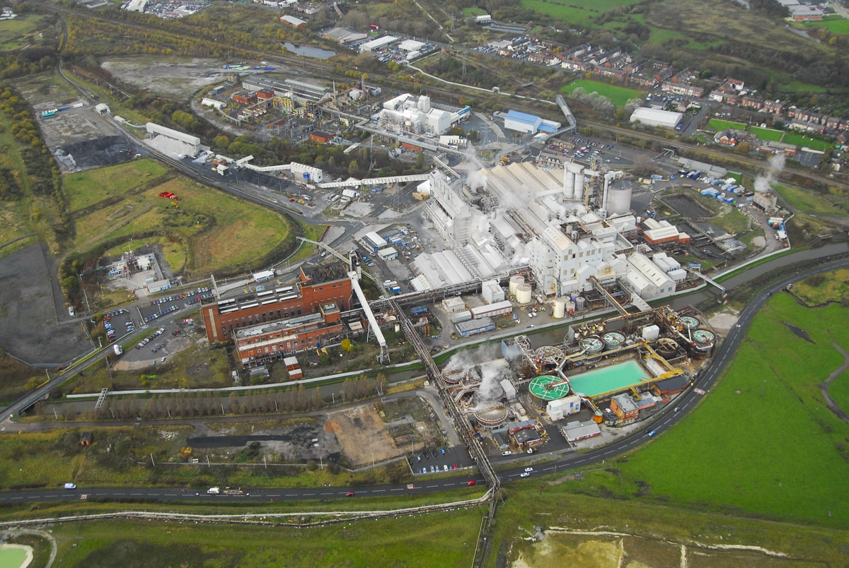
Lostock Site Aerial

Slide 9
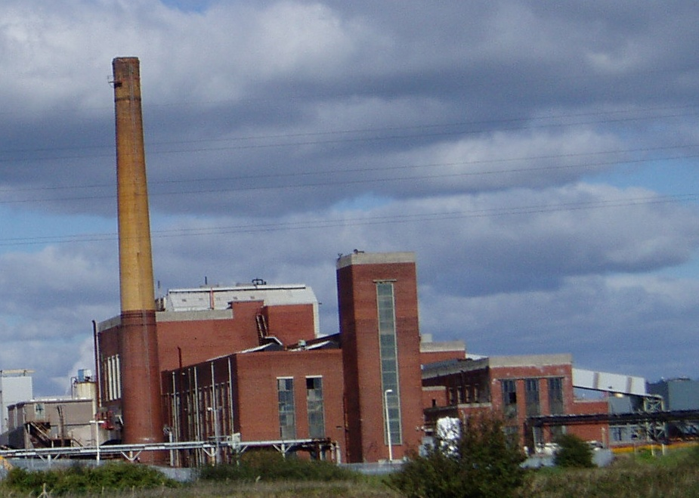
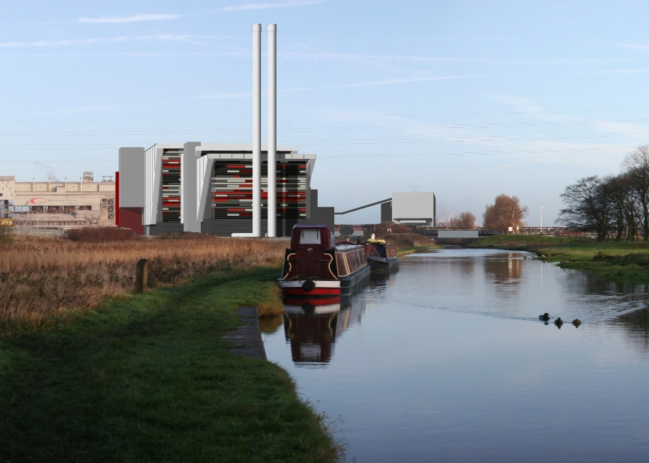
Lostock Sustainable Energy Plant SEP - Overview

Slide 10
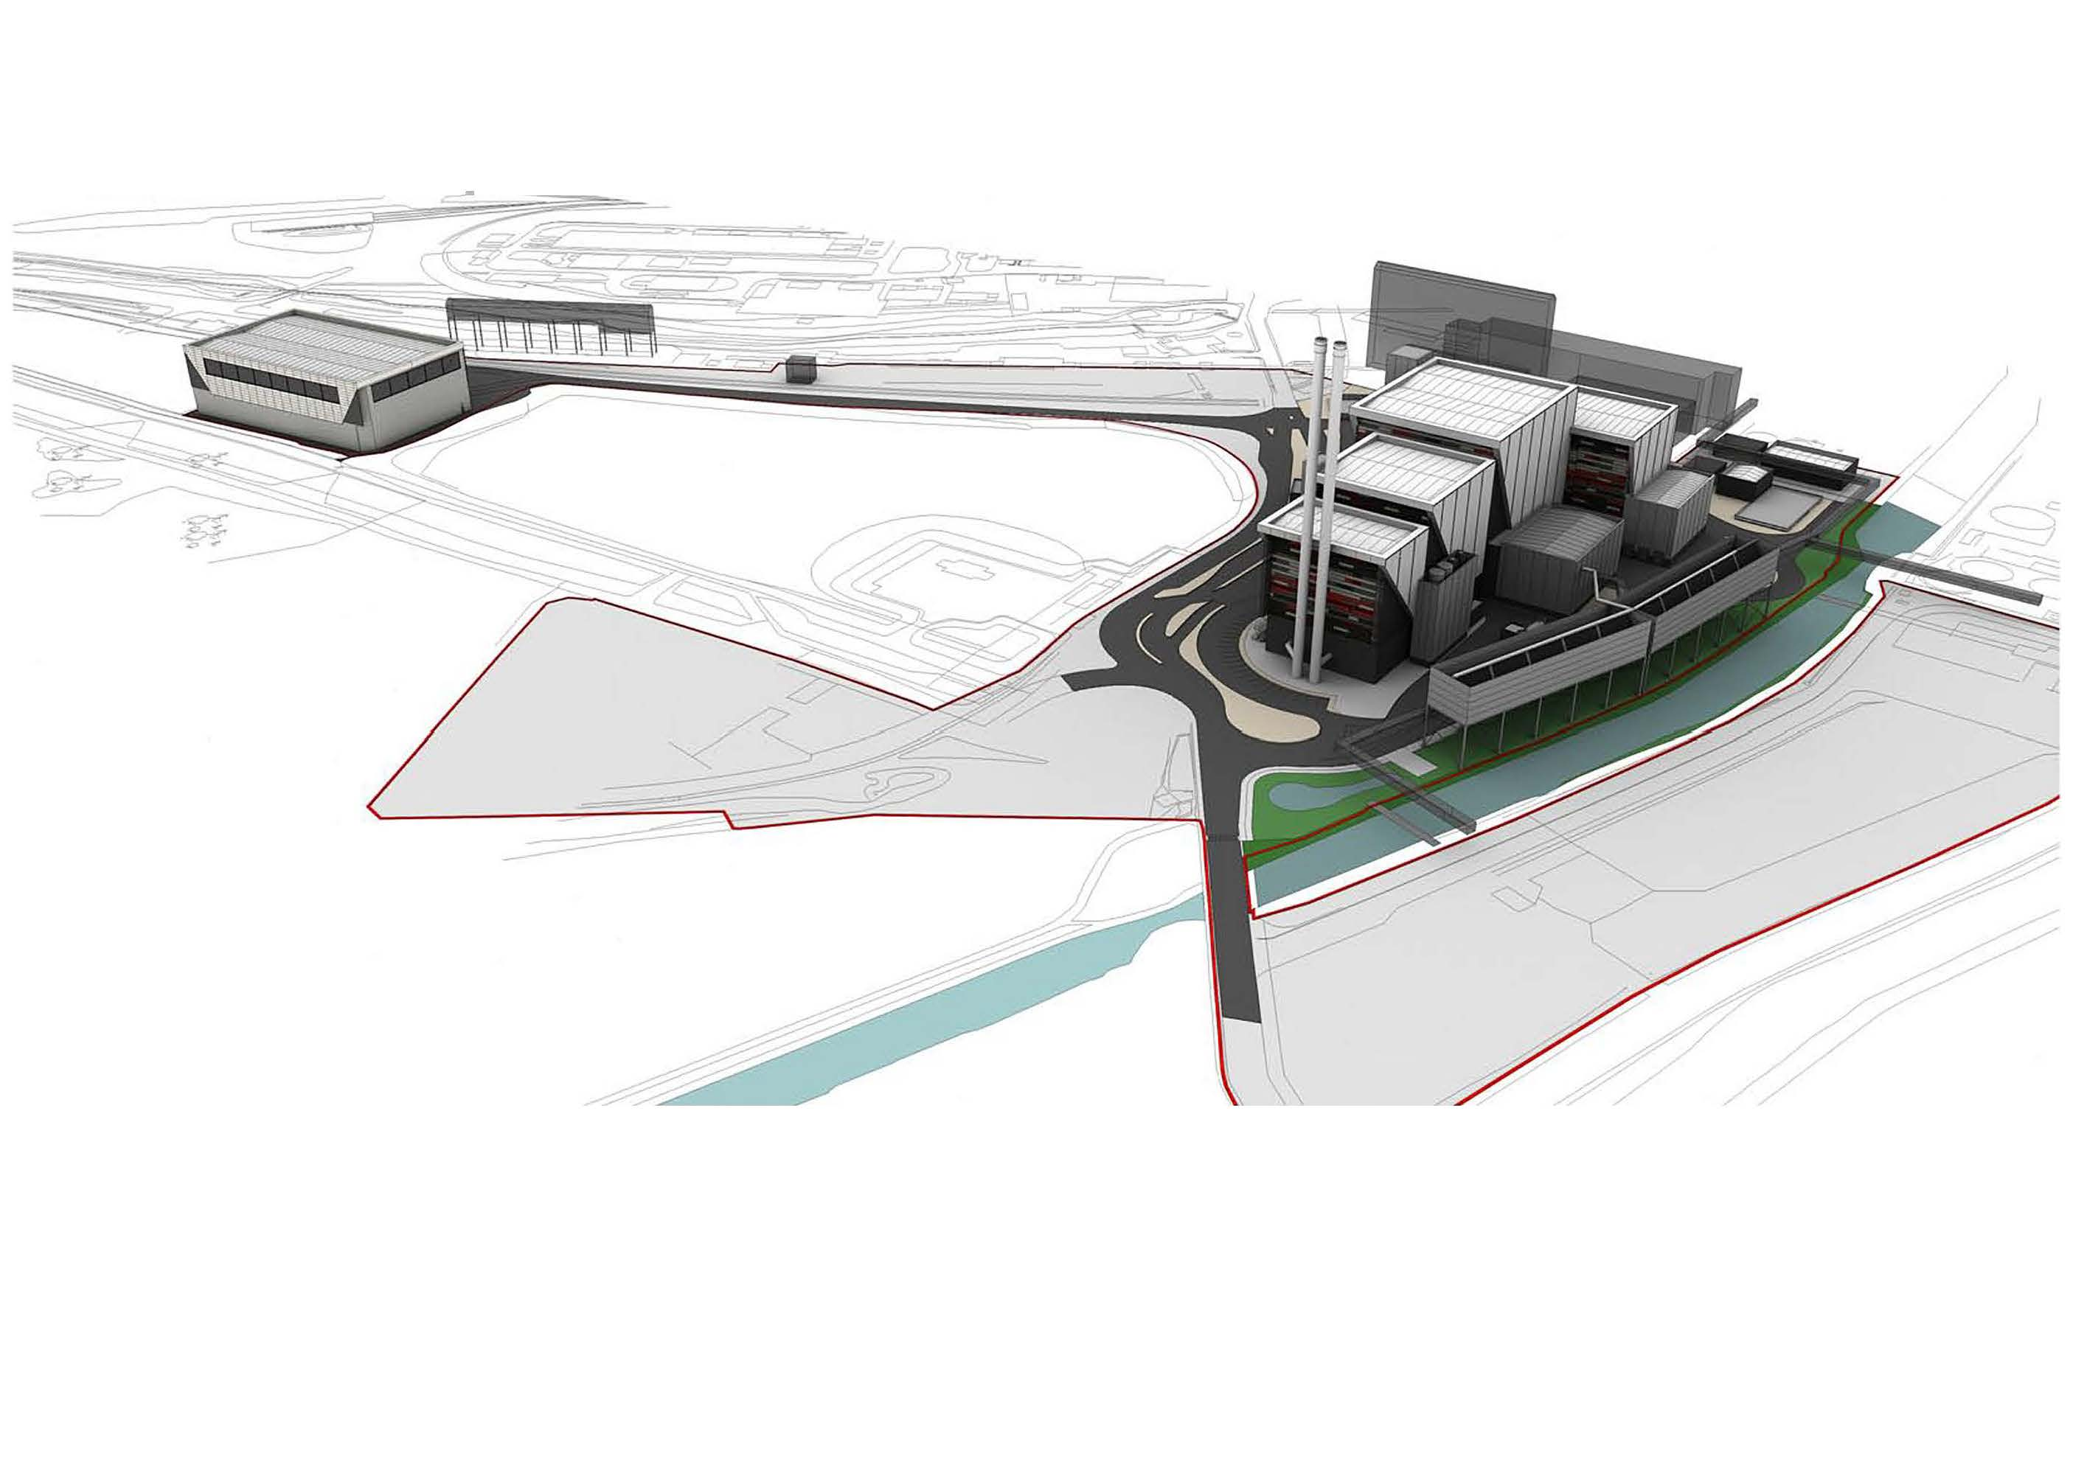
Lostock SEP: Project Overview

Slide 11
Lostock SEP Project
  Update on Site Works Since Last Meeting

Slide 12
Update since Last LLC Meeting
Thirteen Pre-commencement Planning Condition applications discharged by CWaCC in July 2017 after consultation with relevant statutory consultees.
First phase of site works commenced in August and completed in September. Work included:
  Securing site boundary
  External building surveys
  Vegetation clearance
  Demolition of a number of the external building structures

Slide 13
Update since Last LLC Meeting

Slide 14
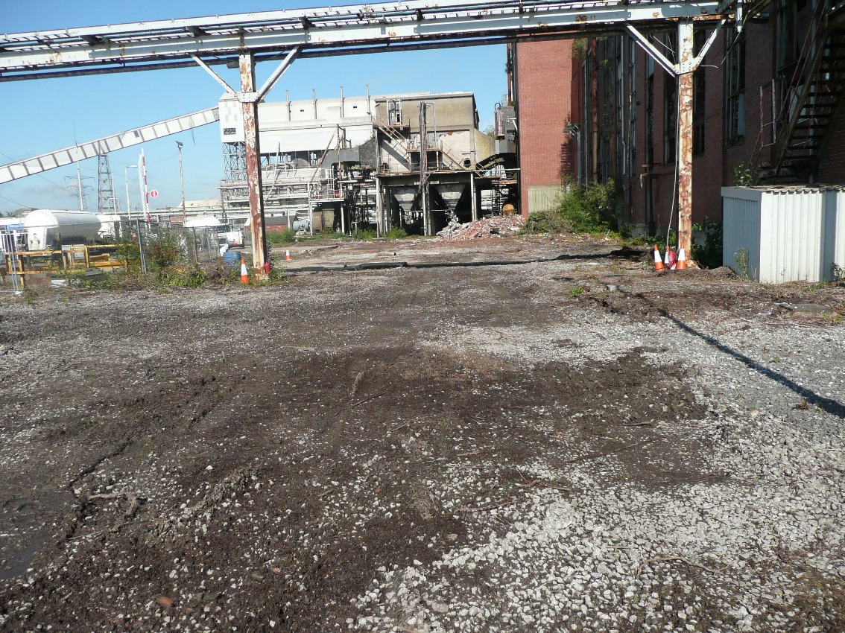
Update since Last LLC Meeting
Photograph: 1
Indicating demolition of external buildings:
Power station operations office: E1
Garage: E2
Power Maintenance workshop:E3
Percipitator electrical sub-stationE4

Slide 15
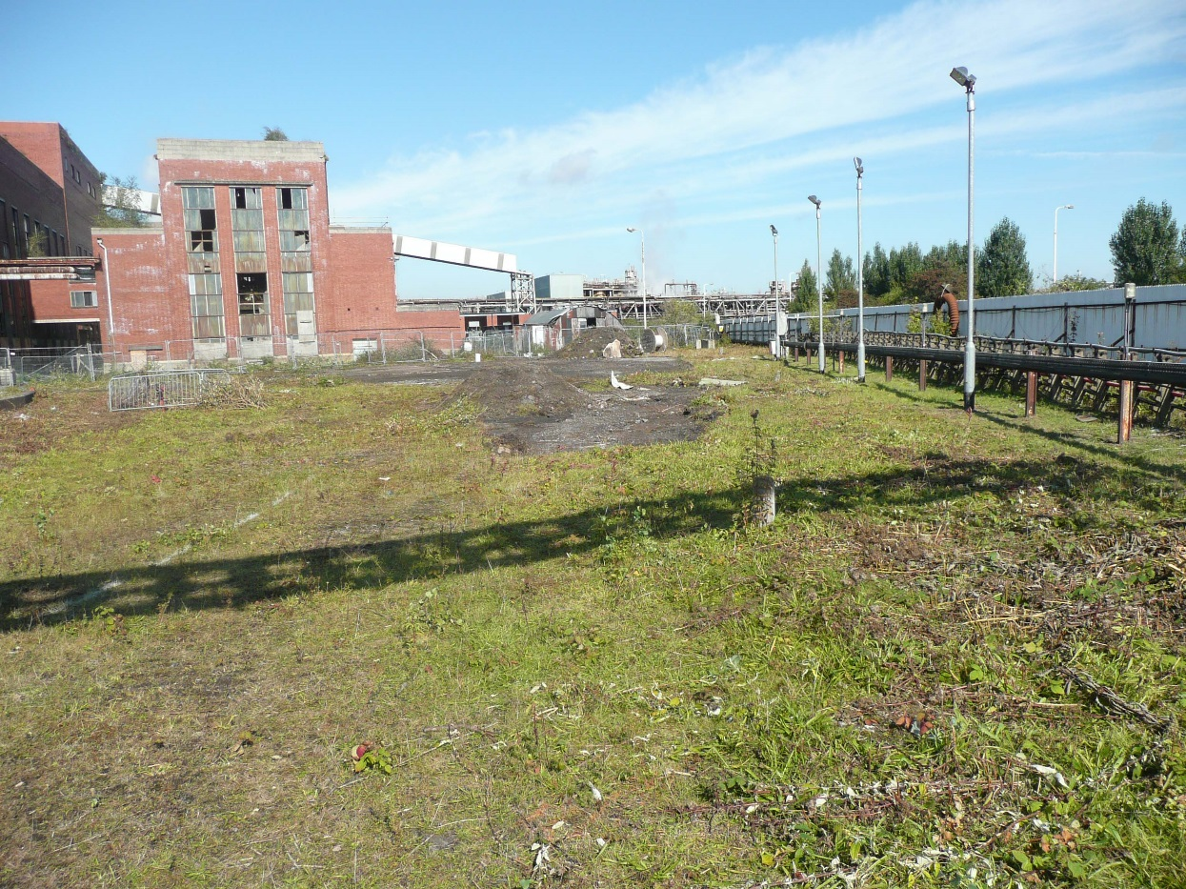
Update since Last LLC Meeting
Photograph: 2
View on canal side looking north showing vegetation clearance

Slide 16
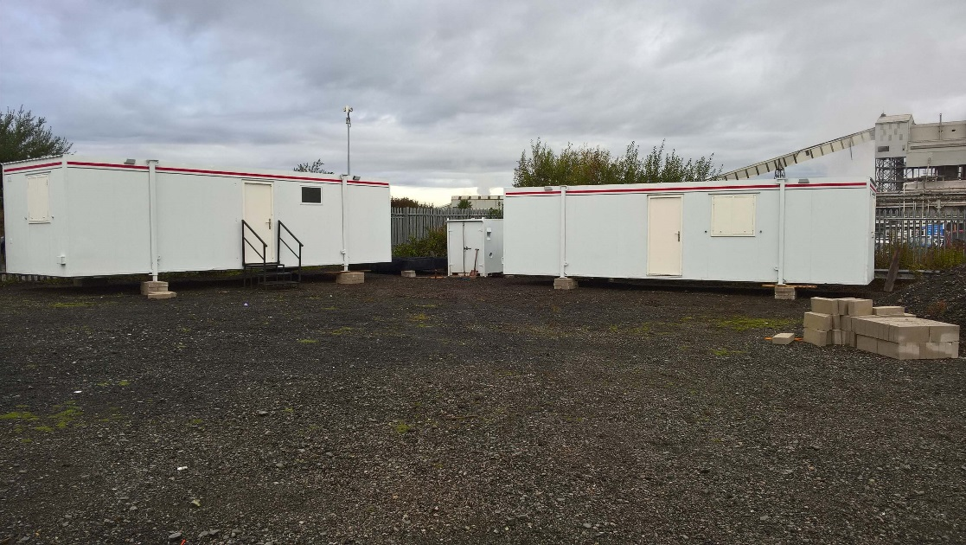
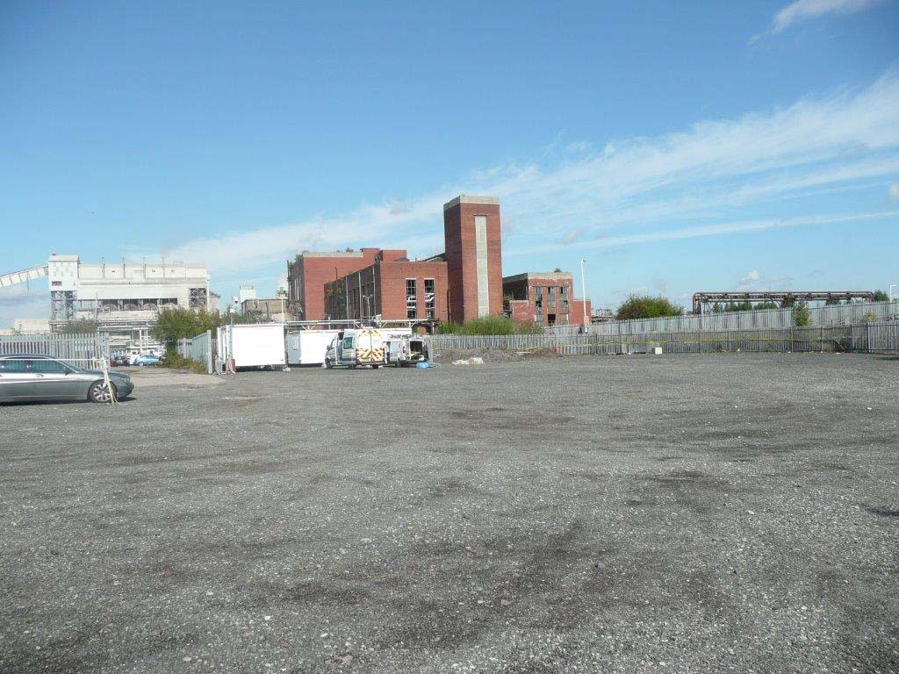
Update since Last LLC Meeting
Photograph: 3 & 4
View of Contractor Compound

Slide 17
Lostock SEP Project
Proposed Work Activities Over Next 3 to 6 Months

Slide 18
Proposed Work Activities over next 3 to 6 Months
Collection of the necessary information and assessments to meet the requirements of planning condition 26 discharge approval (Prevention of Contamination of Land).
  Includes further ground investigation work to satisfy CWACC & EA requirements
    Additional monitoring works, analysis, interpretation and reporting
    Expect to take up to 6 months to complete
Continue development works to optimise the design and efficiency of the EfW plant.
  TATA in line with EA requirements need to optimise the efficiency of the proposed plant; based on the permitted waste fuel deliveries specified in the planning consent.
  Detailed energy efficiency studies based on latest technology advances

Slide 19
Lostock SEP Project
Subsequent Project Works

Slide 20
Lostock SEP: Subsequent Project Works
Efforts during 2018 will largely focus on
  the enabling work packages
  subsequent demolition of the old coal fired power station, which is likely to take place in 2019
Stevie Mitchell appointed as TATA Site Integration Manager for Lostock SEP. Stevie is responsible for leading and delivering the site enabling activities on TATA’s behalf
Scoping of the enabling work packages, approximately 15 discrete packages.
  Complex activities due to interface with existing operating facilities
  Live services (water, electricity, steam, chemicals, telecommunications, IT) running across the development land; both above and under ground need to be diverted.
  Relocate water plant and electrical infrastructure
  Relocate offices and workshop facilities

Slide 21
Lostock SEP Project
Communication Routes for LLC Outputs
Determine appropriate methods of communicating the information and output of the Local Liaison Committee with third party organisations and the public

Slide 22
Lostock SEP Project
AOB
Dates of next meeting: Thursday 1st March 2018, 2 PM TATA Lostock site.

