Slide 1
Lostock Sustainable Energy Plant (SEP)
Local Liaison Committee
24th August 2017

Slide 2
AGENDA
Introductions
Site Rules
Purpose of Local Liaison Committee
Project Overview
Pre-commencement Planning Conditions Overview
Commencement Works
Site Visit
Points of Clarification
Future Meeting Dates
AOB
Local Representative

Slide 3
Lostock Site Rules
Chemical Manufacturing Complex operating under strict Safety Rules and Procedures
TATA representative will act as Guardian
No fire alarm test planned for today. If alarm sounds follow Guardian to muster point outside gatehouse
Toilet facilities in office block next door
Smoking prohibited on site.

Slide 4
Purpose of Local Liaison Committee
Voluntary undertaking which TATA entered into within the Section 106 Agreement relating to the planning consent for the Lostock Sustainable Energy Plant
Purpose of the Local Liaison Committee is to:
Maintain close links and communication with the local community and businesses within the area
Enable people to gain a greater understanding of the construction, commissioning and future operation of the facility
Enable local people to raise any questions or points of concern
Enable TATA and / or the EfW development and operations team to understand and respond to the views of local people
Enable TATA to give early warning to local residents and businesses of abnormal construction activity, temporary diversion, deliveries etc, with the aim to minimise the effects of any disturbances

Slide 5
Operating Principles for Local Liaison Committee
Operating Principles for the Local Liaison Committee:
Open and inclusive committee forum with a membership interested in the Lostock SEP facility
Membership consisting of nominated representatives of local Parish councils, Town Council and local residents. Also officer or member from CWaCC; TATA and it’s EfW development / operations team
External guests will be invited to attend a specific meeting where their knowledge will enhance understanding (for example: Environment Agency or construction expert
Agreed meeting agenda and minutes produced
Agreed meeting frequency; current suggestion is quarterly.

Slide 6
Project Overview
Lostock Site History and Overview
Lostock Site commenced soda ash production in 1907; Brunner Mond acquired the site in 1904. Demolished and rebuilt new manufacturing plant.
Manufacturing complex expanded as production capacity increased and new products were produced.
Brunner Mond was a key company in the development of ICI in 1926
Brunner Mond divested from ICI in 1991.
ICI retained some parts of the Lostock site and sold to third parties
TATA Chemicals Ltd acquired Brunner Mond in 2005
TATA produce the following products at the Lostock site:
Soda Ash (Sodium Carbonate)
Sodium Bicarbonate (Bicarbonate of Soda)
Hydrated Lime (Milk of Lime)
Crex (Sodium Sesqui-carbonate)

Slide 7
Project Overview
Lostock Site History and Overview, cont’d
Soda ash produced from brine (NaCl) and Carbon Dioxide (CO2)
Brine supplied from the Holford salt cavities operated by Inovyn
Carbon dioxide produced from the thermal decomposition of limestone with coke. Limestone railed in from Buxton
Ammonia is used as a catalyst (pH conditioner) to assist the chemical reaction
Soda Ash production is energy (heat) intensive. Steam required to drive the chemical reactions and dry the product.
The site operated its own coal fired power station (six boilers) up to the year 2000. Decommissioned when new gas fired CHP power plant started at Winnington

Slide 8
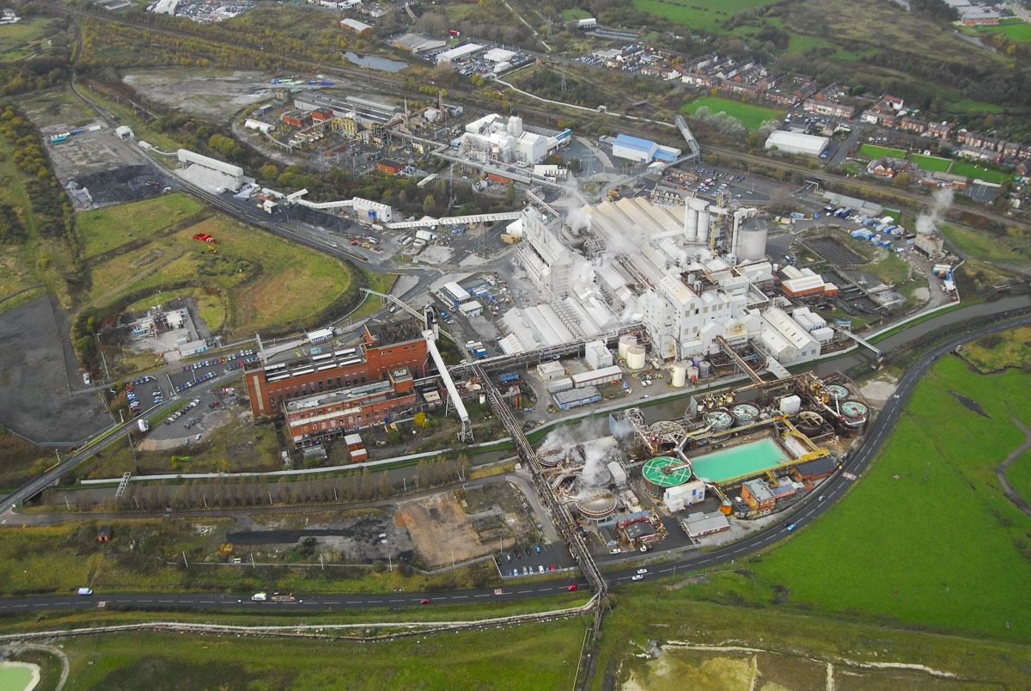
Lostock Site Aerial

Slide 9
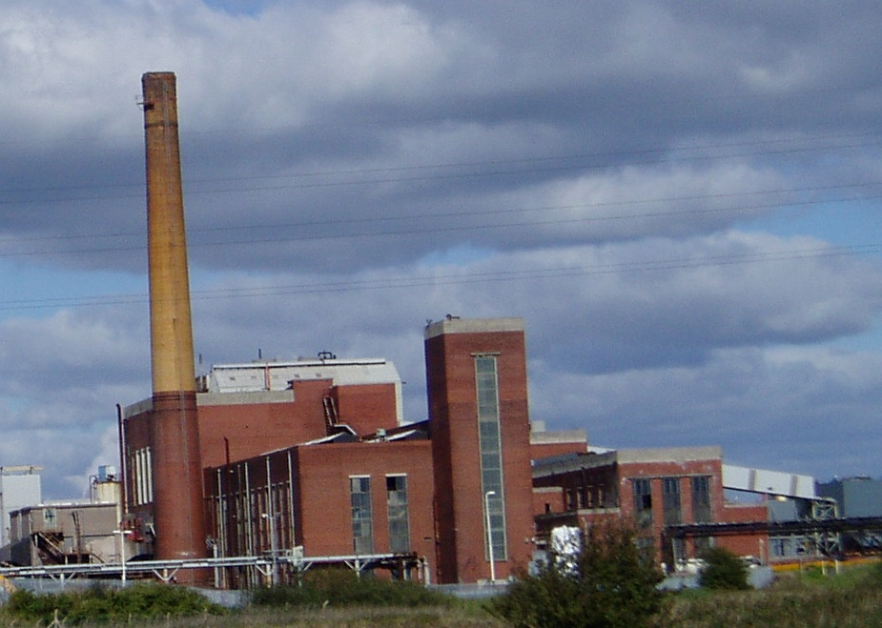
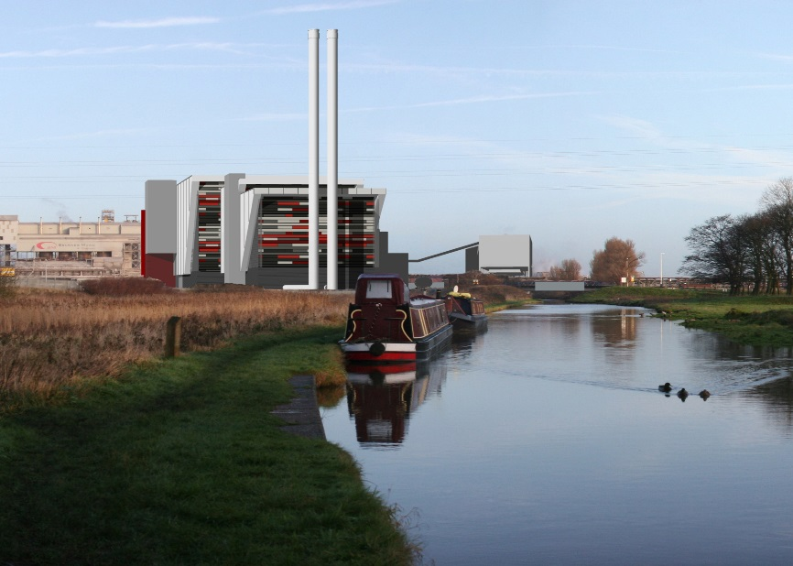
Lostock Sustainable Energy Plant SEP - Overview

Slide 10
Lostock SEP: Project Overview
Project initiated in 2010 as a joint venture between TATA and E.on Energy from Waste (EEW).
Planning application submitted to the Department of Energy and Climate Change (under Section 36 Electricity Act 1989) in February 2010
Public Inquiry held in October 2011 over a 5 week period
Planning consent awarded in October 2012
TATA acquired EEW’s interest in the project and implementation structure redefined.
Extensive development activities with preferred civil engineering and technology providers: SISK and Baumgarte.

Slide 11
Lostock SEP: Project Overview
Sustainable Energy Plant will produce approx. 50 MWe of electricity exported to the National Grid. TATA will take steam for its chemical manufacturing process
The plant will take up to 600,000 tonnes per year of refuse derived fuel (RDF)
The new power plant will be constructed on the site of the redundant coal fired power station
Prior to construction an extensive demolition and enabling phase of works needs to be completed including:
Asbestos removal
Replacement and relocation of key electrical and water treatment facilities
Replacement and relocation of offices, workshops, storage facilities
Demolition
Construction of new power plant will take in the region of 3 years

Slide 12
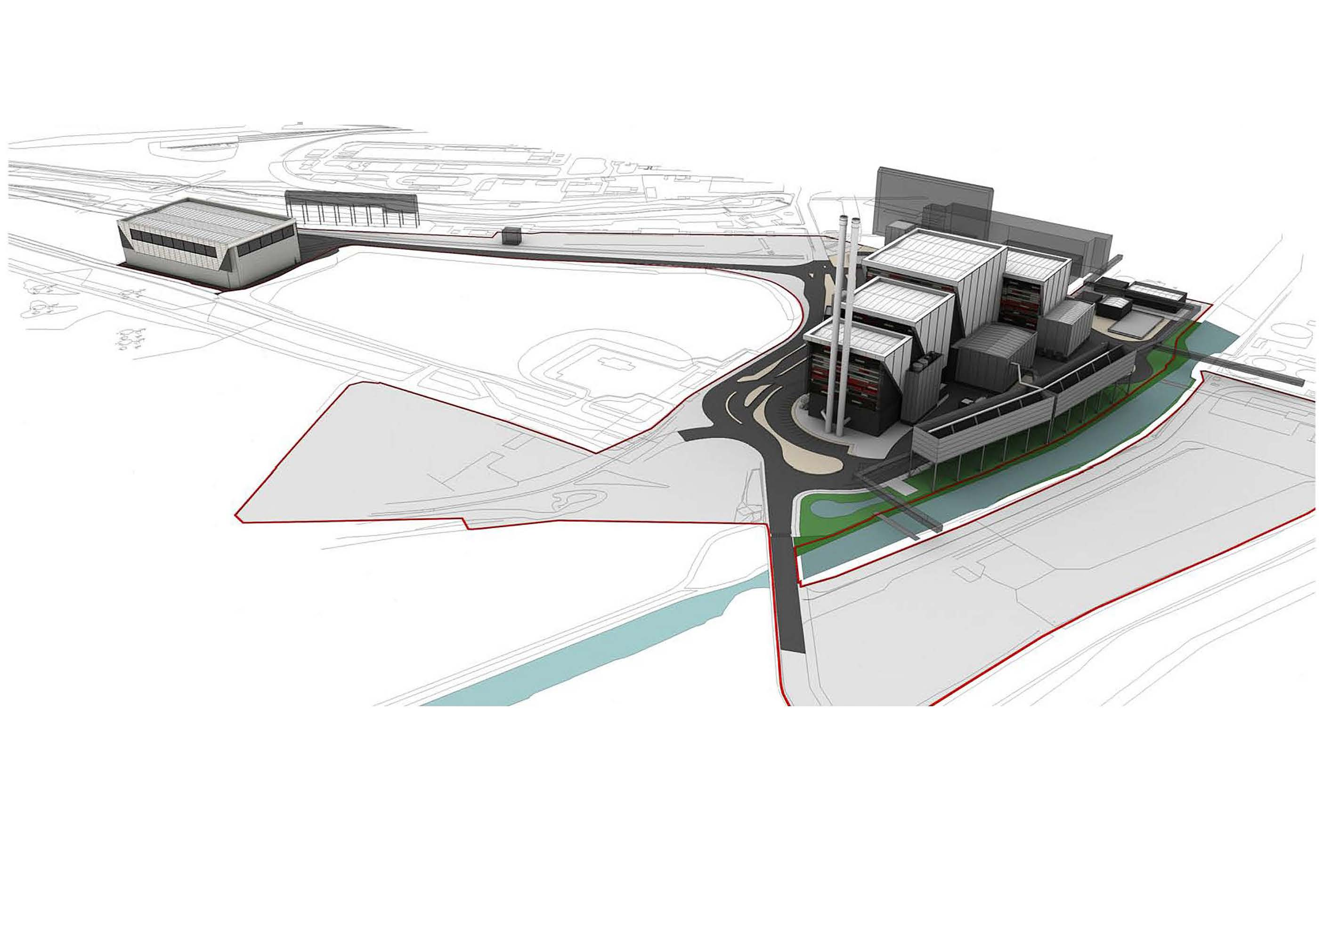
Lostock SEP: Project Overview

Slide 13
Lostock SEP: Current Situation
Thirteen Pre-commencement Planning Condition applications submitted to CWaCC in March 2017. Available on the CWaCC planning portal.
CWaCC discharged conditions in July 2017 after consultation with relevant statutory consultees
First phase of site works due to commence later in August. Work to include:
Securing site boundary
External building surveys
Vegetation clearance
Demolition of a number of the external building structures
Follow on work in near future will include further ground contamination surveys to satisfy EA requirements
Followed by final detail scoping of the various enabling work packages

Slide 14
Lostock SEP: AGENDA Activities
Site Visit
Points of Clarification
Future Meeting Dates
A.O.B
Local representative nominee

